Slide 1
Abstract Data Types
Iterators
Vector ADT and Implementation
Notes:
Introduction
Welcome to COP 4530, Data Structures, Algorithms, and Generic Programming. I hope very much, and sincerely believe, that this course will change you in ways that are deeply satisfying. So far, you have acquired proficiency in programming. This course will start the process of your transformation from a programmer to a computer scientist. One of the important tasks of a computer scientist is to make efficient use of computational resources. This course will teach you about different ways of organizing the data to facilitate such efficient use, and will also discuss efficient techniques to perform some fundamental operations in computer science. A subsequent course on Algorithms, COP 4531, will teach you to use the techniques discussed in this course to solve commonly encountered computer science problems efficiently. Both these courses will also teach you to analyze the efficiency, and prove the correctness, of your program in a mathematically rigorous manner. Material you learn in these two courses is critical to your becoming a good software developer later.

Slide 2
Abstract Data Type (ADT)
High-level definition of data types
An ADT specifies
  A collection of data
  A set of operations on the data or subsets of the data
ADT does not specify how the operations should be implemented
Examples
  vector, list, stack, queue, deque, priority queue, table (map), associative array, set, graph, digraph

Slide 3
Containers and Iterators
An iterator abstracts the process of scanning through a collection of elements
A container is an abstract data structure that supports element access through iterators
  begin(): returns an iterator to the first element
  end(): return an iterator to an imaginary position just after the last element
An iterator behaves like a pointer to an element
  *p: returns the element referenced by this iterator
  ++p: advances to the next element
Extends the concept of position by adding a traversal capability

Slide 4
Containers
Data structures that support iterators are called containers
Examples include Stack, Queue, Vector, List
Various notions of iterator:
  (standard) iterator: allows read-write access to elements
  const iterator: provides read-only access to elements
  bidirectional iterator: supports both ++p and --p
  random-access iterator: supports both p+i and p-i

Slide 5
Iterating through a Container
Let C be a container and p be an iterator for C
  for (p = C.begin(); p != C.end(); ++p)
    loop_body
Example: (with an STL vector)
    typedef vector<int>::iterator Iterator;
    int sum = 0;
    for (Iterator p = V.begin(); p != V.end(); ++p)
    sum += *p;
    return sum;

Slide 6
Implementing Iterators
Array-based
  array A of the n elements
  index i that keeps track of the cursor
  begin() = 0
  end() = n (index following the last element)
Linked list-based
  doubly-linked list L storing the elements, with sentinels for header and trailer
  pointer to node containing the current element
  begin() = front node
  end() = trailer node (just after last node)

Slide 7
STL Iterators in C++
Each STL container type C supports iterators:
  C::iterator – read/write iterator type
  C::const_iterator – read-only iterator type
  C.begin(), C.end() – return start/end iterators
This iterator-based operators and methods:
  *p: access current element
  ++p, --p: advance to next/previous element
  C.assign(p, q): replace C with contents referenced by the iterator range [p, q) (from p up to, but not including, q)
  insert(p, e): insert e prior to position p
  erase(p): remove element at position p
  erase(p, q): remove elements in the iterator range [p, q)

Slide 8
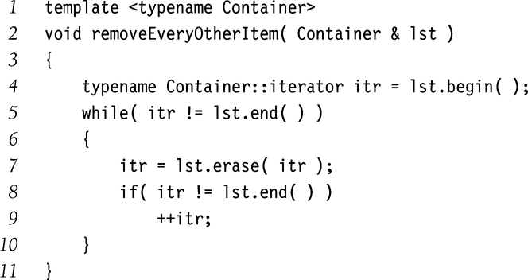
Iterator example

Slide 9
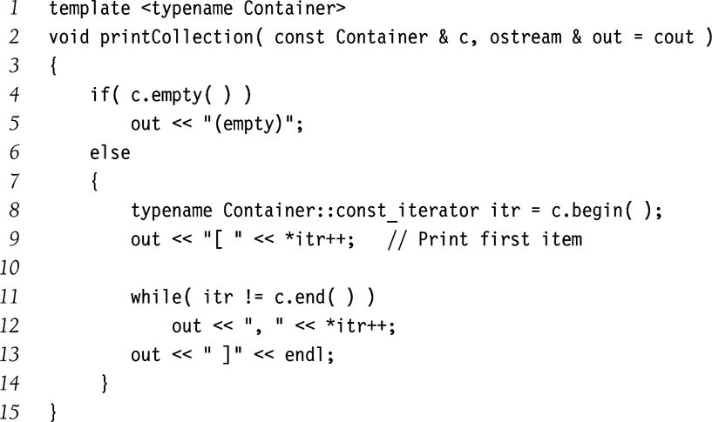
const_iterator
Returns a constant reference for operator*
So that a function does not try to modify the elements of a constant container object.
Note that c.begin() and c.end() functions in the example return const_iterator type.

Slide 10
The Vector ADT
Generic arrays

Slide 11
The Vector ADT
Extends the notion of array by storing a sequence of arbitrary objects
Elements of vector ADT can be accessed by specifying their index.

Slide 12
Vectors in STL
Collection ➔ Elements of some proper type T
Operations
  int size() ➔ returns the number of elements in the vector
  void clear() ➔ removes all elementes from the vector
  bool empty() ➔ returns true of the vector has no elements
  void push_back ( const Object &x )
    adds x to the end of the vector
  void pop_back ( )
    Removes the object at the end of the vector
  Object & back ( )
    Returns the object at the end of the vector
  Object & front ( )
    Returns the object at the front of the vector

Slide 13
Vectors in STL (contd.)
More Operations
  Object & operator[] ( int index )
    Returns the object at location index (without bounds checking)
    Both accessor and mutator versions
  Object & at( int index )
    Returns the object at location index (with bounds checking)
  int capacity()
    Returns the internal capacity of the vector
  void reserve(int newCapacity)
    Sets the new capacity of the vector
  void resize(int newSize )
    Change the size of the vector

Slide 14
Implementing Vector Class Template
Vector maintains
  A primitive C++ array
  The array capacity
  The current number of items stored in the Vector
Operations:
  Copy constructor
  operator=
  Destructor to reclaim primitive array.
  All the other operators we saw earlier.

Slide 15
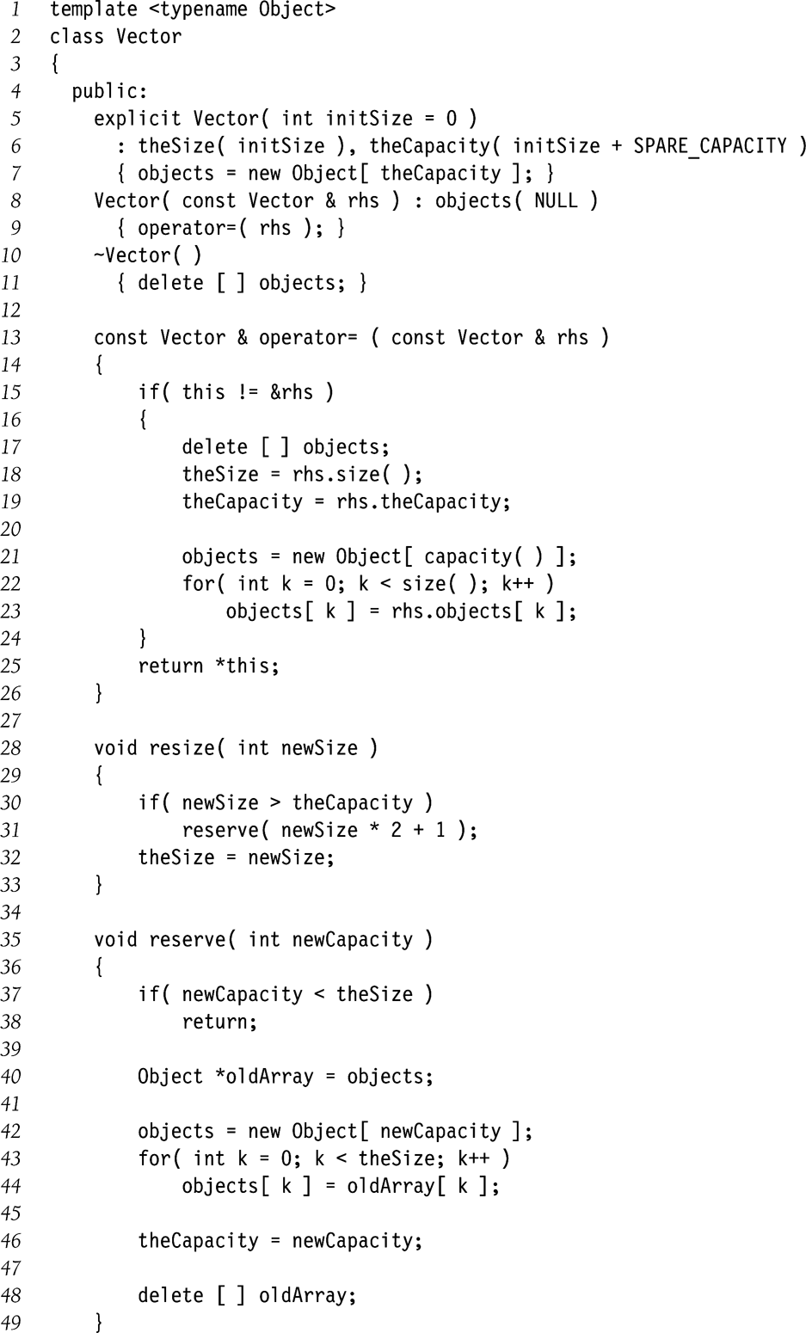
Vector Implementation (Part 1)
➔Constructor
➔Copy Constructor
➔deep copy assignment

Slide 16
Vector Implementation (Part 2)
Expand to twice as large
because memory allocation
is an expensive operation

Slide 17
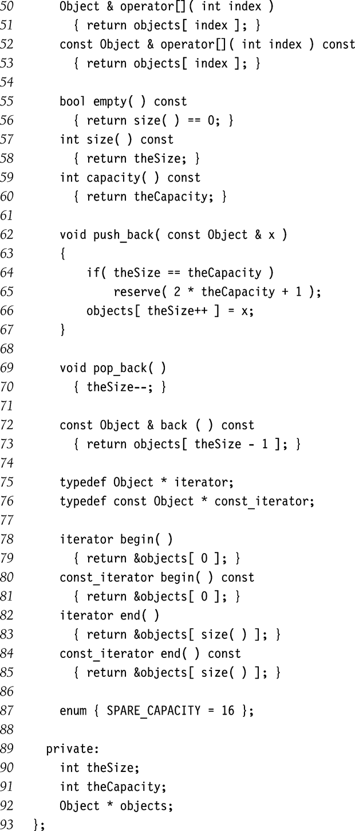
Vector Implementation (Part 3)
No error checking

Slide 18
Vector Implementation (Part 4)
Same as pointers to Object

